Slide 1
What is UML?
UML is a language for
  Visualizing
  Specifying
  Constructing
  Documenting

Slide 2
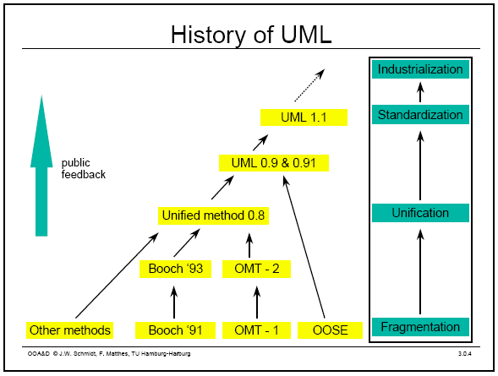
History of UML
Notes:
History:
- Rumbaugh – OMT – object modeling technique
Jacobson – OOSE
UML … unified approach since 1995
UML 1.5 current … UML 2.0 by the end of 2004

Slide 3
Types of UML Diagrams
Use Case Diagram
Class Diagram
Sequence Diagram
Collaboration Diagram
State Diagram
This is only a subset of diagrams … but are most widely used

Slide 4
Use Case Diagram
Used for describing a set of user scenarios
Mainly used for capturing user requirements
Work like a contract between end user and software developers

Slide 5
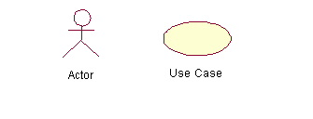
Use Case Diagram (core components)
Actors: A role that a user plays with respect to the system,including human users and other systems. e.g.,inanimate physical objects (e.g. robot); an external system that needs some information from the current system.
Use case: A set of scenarios that describing an interaction between a user and a system, including alternatives
System boundary: rectangle diagram representing the boundary between the actors and the system.

Slide 6
Use Case Diagram(core relationship)
Include: a dotted line labeled <<include>> beginning at base use case and ending with an arrows pointing to the include use case. The include relationship occurs when a chunk of behavior is similar across more than one use case. Use “include” in stead of copying the description of that behavior.
<<include>>
Extend: a dotted line labeled <<extend>> with an arrow toward the base case. The extending use case may add behavior to the base use case. The base class declares “extension points”.
<<extend>>

Slide 7
What is a Model?
A model is a simplification of reality.
A model may provide
  blueprints of a system
  Organization of the system
  Dynamic of the system

Slide 8
Why We Model
“A successful software organization is one that consistently deploys quality software that meets the needs of its users. An organization that can develop such software in a timely and predictable fashion, with an efficient and effective use of resources, both human and material, is one that has sustainable business.”

Slide 9
Why We Model
Model is built to
  Communicate the desired structure and behavior of the system
  Visualize and control the system’s architecture
  Better understand the system that being built
  Manage risk
  Expose opportunities for simplification and reuse

Slide 10
Why We Model
Model is built to
  Communicate the desired structure and behavior of the system
  Visualize and control the system’s architecture
  Better understand the system that being built
  Manage risk
  Expose opportunities for simplification and reuse

Slide 11
Importance of Modeling
Models help us
  to visualize a system as it is or as we want it to be.
  to specify the structure or behavior of a system.
  in providing a template that guides us in constructing a system.
  in providing documenting the decisions we have made.

Slide 12
Principles of Modeling
The choice of what models to create has a major influence on how a problem is approached and how a solution is shaped.
Every model may be expressed at different levels of precision.
The best models are connected to reality.
No single model is sufficient. Every nontrivial system is best approached through a small set of nearly independent models.

Slide 13
Objected-Oriented Modeling
Two most common ways in modeling software systems are
  Algorithmic
    Procedures or functions
  Object oriented
    Objects or classes

Slide 14
Conceptual Model
It is a set of static structure diagrams with classes, attributes, Associations but no operations
Analysis goal: Build conceptual model
* Represent an aspect of reality
* Helps Software engineers manage complexity
* Is simpler than reality
Conceptual model should
* organize data into objects and classes
* Structure data via Inheritance / Associations
* Specify behavior and public interfaces
* describe global behaviour
* Describe constraints on system behaviour
* The conceptual model is build on more advanced features of the language.
The vocabulary of the UML encompasses three kinds of building blocks
1. Things-----abstraction
2. Relationship ----- Tie things together
3. Diagram --------- Group interesting collection of things

Slide 15
Structural things
They are the nouns of UML models
They represent the elements that are either conceptual or physical
There are seven kinds of structural things
1. Class
2. Interface
3. Collaboration
4. Use cases
5. Active classes
6. Components
7. Nodes

Slide 16
Class
A class defines a template for creating or instantiating its instances or objects.
A class is a description of a set of objects that share the same attributes, operations, relationships, and semantics.
Each class is represented by a rectangle subdivided into three compartments
  Name
  Attributes
  Operations
Modifiers are used to indicate visibility of attributes and operations.
  ‘+’ is used to denote Public visibility (everyone)
  ‘#’ is used to denote Protected visibility (friends and derived)
  ‘-’ is used to denote Private visibility (no one)
By default, attributes are hidden and operations are visible.

Slide 17
An example of Class
Name
Account_Name
- Customer_Name
- Balance
Attributes
+addFunds( )
+withDraw( )
+transfer( )
Operations

Slide 18
Interface
It is a collection of operations it specifies a service of a class or component
It represents the complete behavior of a class or component or only part of that behaviour
It never stand alone
It is typically attached to the class or component

Slide 19
Collaborations
It defines an interaction and is a society of roles and other elements that work together
It has structural as well as behavioral dimensions
Graphically it is represented as ellipse with dashed line usually including only its name

Slide 20
Use Case
It is a description of set of sequence of actions that a system performs
It is used to structure the behavioural things in a model
Graphically it represented as ellipse with solid lines usually including

